Slide 1
Using Dynamic Languages to Achieve Higher Development Productivity and Agility
Oscar Renalias, JavaSlava 2013

Slide 2
Agenda
What Are Dynamic Languages and Why Are They Important?
Industry Trends
Agility
Use Cases and Enterprise Fit
Synergy With Other Technologies
Challenges and Concerns
Accenture Experience, Skills, and Capability Building
Conclusion

Slide 3
Key characteristics of Dynamic Languages
Dynamic typing
Interpreted
Code conciseness
Support for the interactive REPL (read-evaluate-print loop)
Notes:
Key characteristics: dynamic typing, interpreted, code conciseness and REPL interactive console
Dynamic language with long history: Lisp and Python
Our focus: Generic Language like Groovy, Ruby, Python, Clojure and JavaScript + PHP for web application
Our focus also including strong type functional languages and framework like Scala and Play

Slide 4
Dynamic Languages Are Not New
Lisp, Smalltalk have been around for a long time
Python has been around longer than Java (pre-1995)
Notes:
Key characteristics: dynamic typing, interpreted, code conciseness and REPL interactive console
Dynamic language with long history: Lisp and Python
Our focus: Generic Language like Groovy, Ruby, Python, Clojure and JavaScript + PHP for web application
Our focus also including strong type functional languages and framework like Scala and Play

Slide 5
Our Focus
We distinguish general-purpose dynamic languages from scripting and specialty languages. Our focus:
General purpose: Ruby, Groovy, Clojure, JavaScript, Python
Web application: PHP
Also including statically-typed functional languages and frameworks which support the REPL style and achieve code conciseness through type inference
Scala
Play framework
Notes:
Key characteristics: dynamic typing, interpreted, code conciseness and REPL interactive console
Dynamic language with long history: Lisp and Python
Our focus: Generic Language like Groovy, Ruby, Python, Clojure and JavaScript + PHP for web application
Our focus also including strong type functional languages and framework like Scala and Play

Slide 6










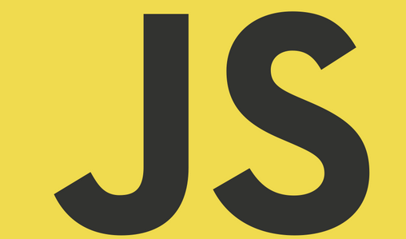








Major Dynamic Language Technologies
Framework
Framework
Framework
Framework
Language
Language
Language
Platform
Platform
Browser
JVM
OS (Unix, Linux, Windows, iOS)
Notes:
Non JVM stack
Ruby:
since 1995, OO with advanced meta-programming feature.
datarich set of Gems and Rails
Groovy and Grails
Python
PHP
JVM stack
Scala
Play framework
Clojure
Jruby, Jpython
JavaScripts
Client side, jQuery, backbone.js (MVC framework)
Server side, node.js to provide non-block IO web server. Web framework: express, FlatIron

Slide 7
Ruby
Overview
Mature language released in 1996
Object-oriented, with advanced meta-programming features
Powerful built-in collections
Functional programming support includes closures, nested blocks, comprehensions
Modularity supported by modules, gems
Extensive library covering almost any conceivable software capability
Ruby gems framework and repositories
Strong documentation frameworks
Powerful testing frameworks
Syntax enables great support for internal DSLs
Lots of good books and training available
Short learning curve for Java developers
JRuby is a fully-compliant Ruby implementation that runs on the JVM
Major web frameworks written in Ruby are Rails (see slide below) and Sinatra
Usage
Chef and Puppet, frameworks for infrastructure deployment automation written in Ruby, are used by hundreds of companies
Cucumber, a Ruby-based behavior-driven-design (BDD) framework, is popular for functional testing of applications written in other languages
See also Rails below.

Slide 8
TODO

